Slide 1

INRODUCTION TO PROGRAMMING
STEM
Notes:
Today we will be completing the BRONZE crest award

Slide 2
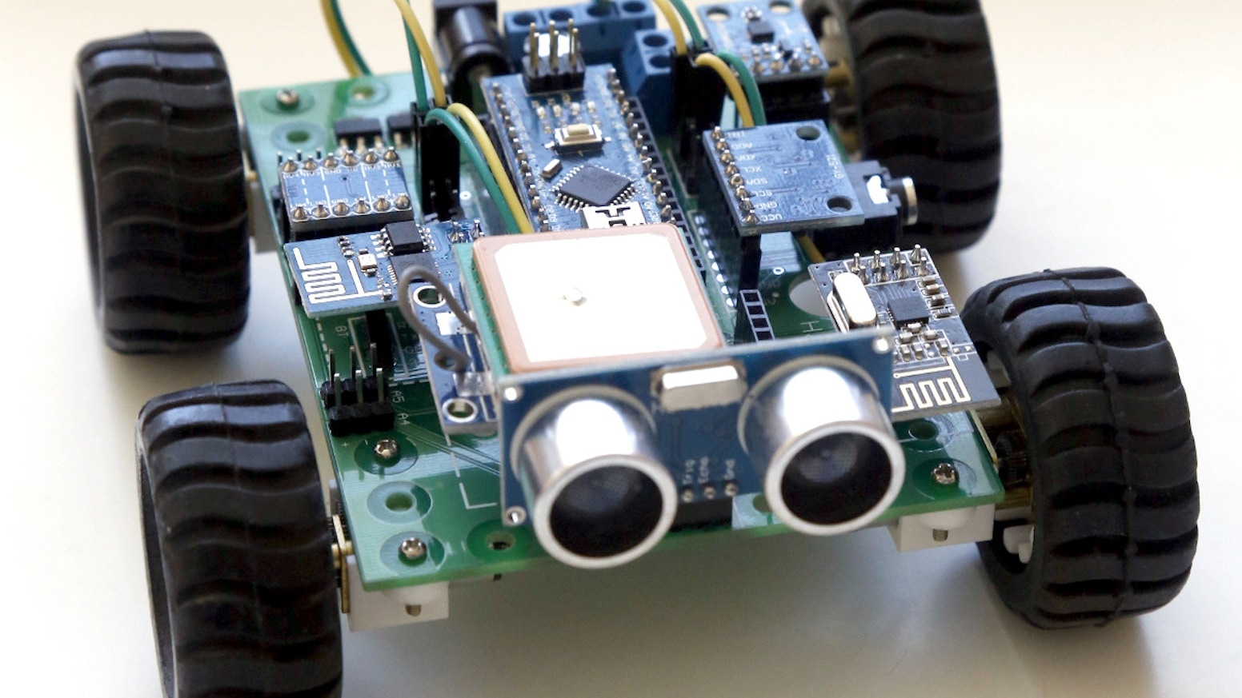
CREST AWARDS
What will we cover?
You should know:
What an Arduino is, what its components are and a basic understanding of how it will work.
What will you cover now?
How to get an output from your Arduino? What does an IDE look like and how do we write code?

Slide 3
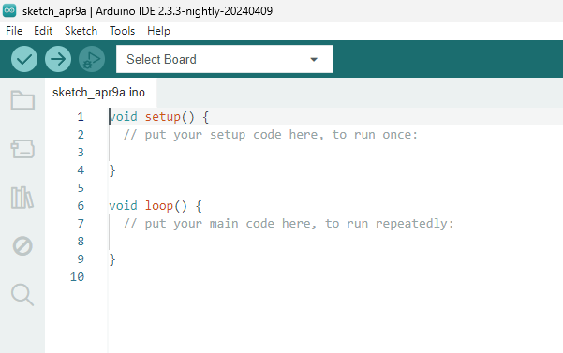
CREST AWARDS
Navigating the IDE
IDE stands for Integrated Development Environment
The upload button is how we transfer the code to the Arduino
This is where you select the board you are wanting to use
This is where the code you will write will go

Slide 4
CREST AWARDS
Functions
Functions are self-contained modules of code
Setup will run when the code is initialised. It will only run once. It is used to instantiate variables and open libraries.
Loop will run infinitely once setup function has ran. Loop is where our code is going to go. It will constantly cycle through.
So what does this mean?

Slide 5
CREST AWARDS
Functions
Functions are self-contained modules of code
Setup
Loop
Start
How can we visualise a project?

Slide 6
CREST AWARDS
Functions
Functions are self-contained modules of code
No
Is there an obstacle?
Setup
Loop
Move forward
Start
Yes
Turn 90 degrees clockwise

Slide 7
CREST AWARDS
Going forward
You should now know:
How to get an output from your Arduino, What an IDE looks like and how to write code. You are now all programmers!
Go forth, and good luck

